Slide 1
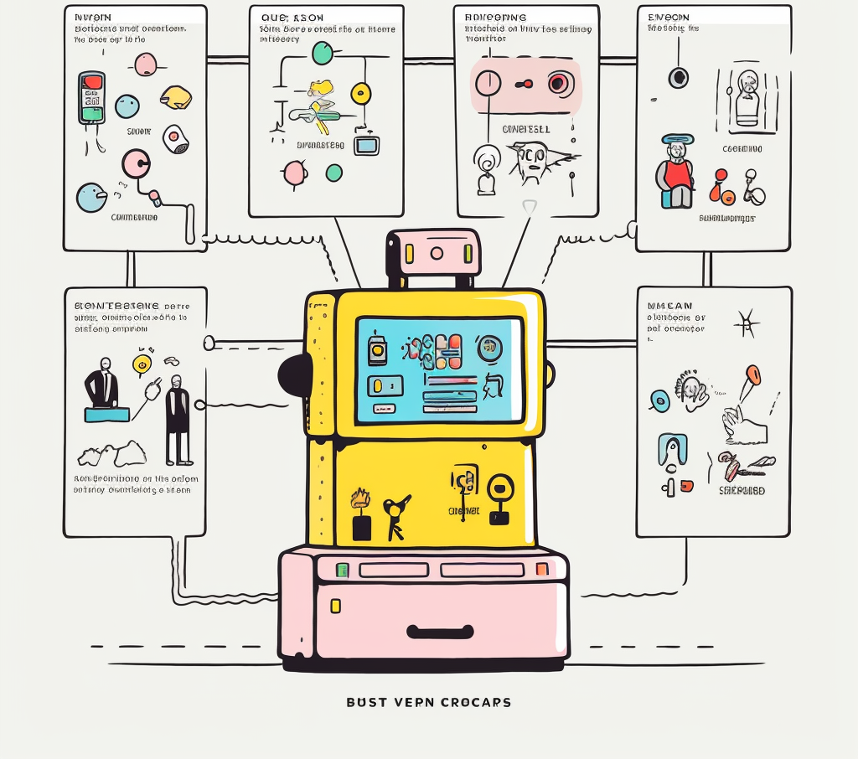
Building a Better Game Review Analyzer
A Flatiron Phase 4 Project by Jordan Loewen-Colón

Slide 2
Today’s Agenda
Business Problem
Goals
Data
Methods
Results

Slide 3

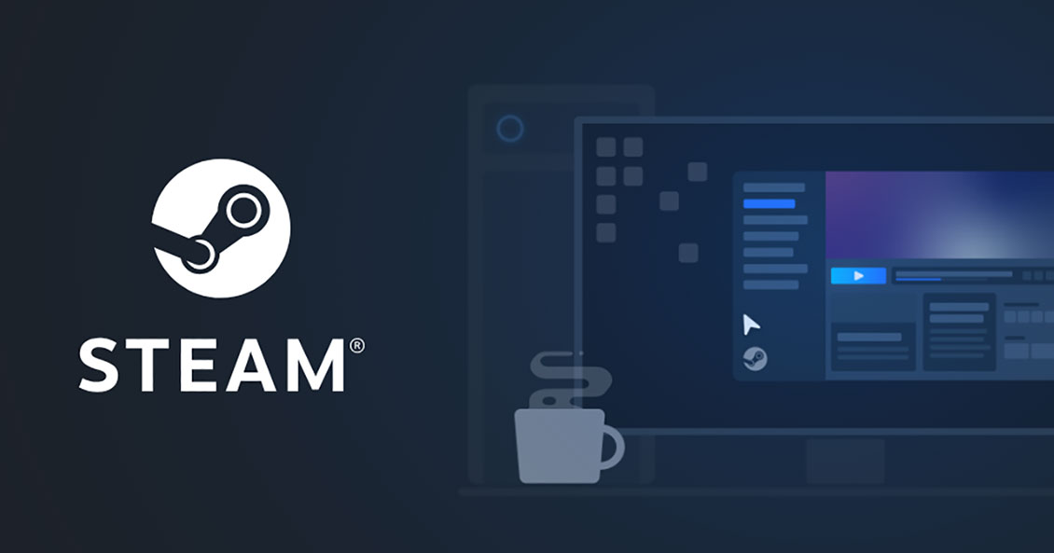
The Problem
SuperGiant Games wants more useful insights from player reviews on Steam. Steam's review system offers a binary recommendation, masking nuanced player feedback. Our project will analyze reviews, focusing on aspects like sound, action, story, visuals. Through sentiment analysis, we aim to identify what elements captivate players. This understanding will guide SuperGiant Games to create more successful, player-centric games.

Slide 4
Primary Goals
Develop
a sentiment analysis model that extends beyond binary evaluations to understand deeper nuances within player reviews.
Aim
To shift from a mere yes/no system to a model that measures specific themes or topics of player interests.
Focus
on key game aspects, such as sound, action, story, and visuals, to understand what elements engage players and define their gaming experience.

Slide 5

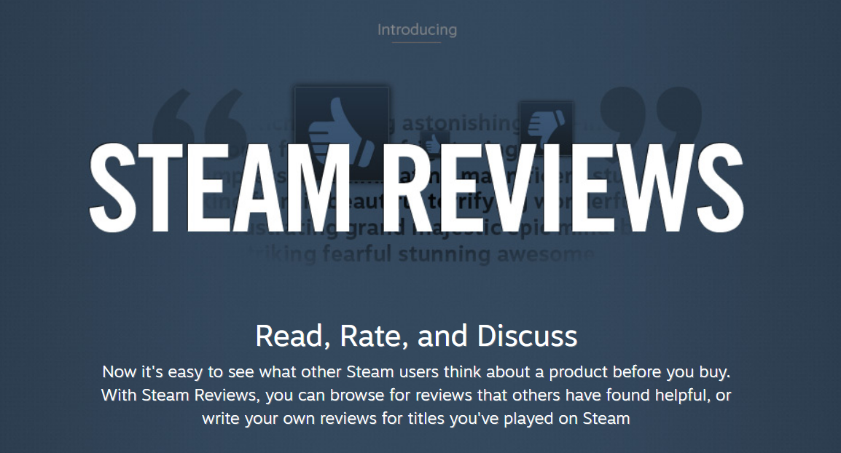
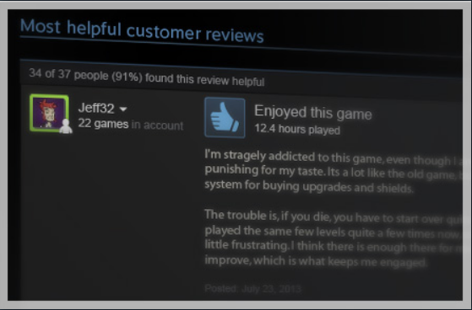
The Data
The dataset has 70k+ entries
The reviews follow a simple binary rating system “voted up” or not.
Other data points include:
Playtime
Purchase data
Whether the review is rated as “funny” by other players

Slide 6
Results
The logistic regression had the highest precision

Slide 7
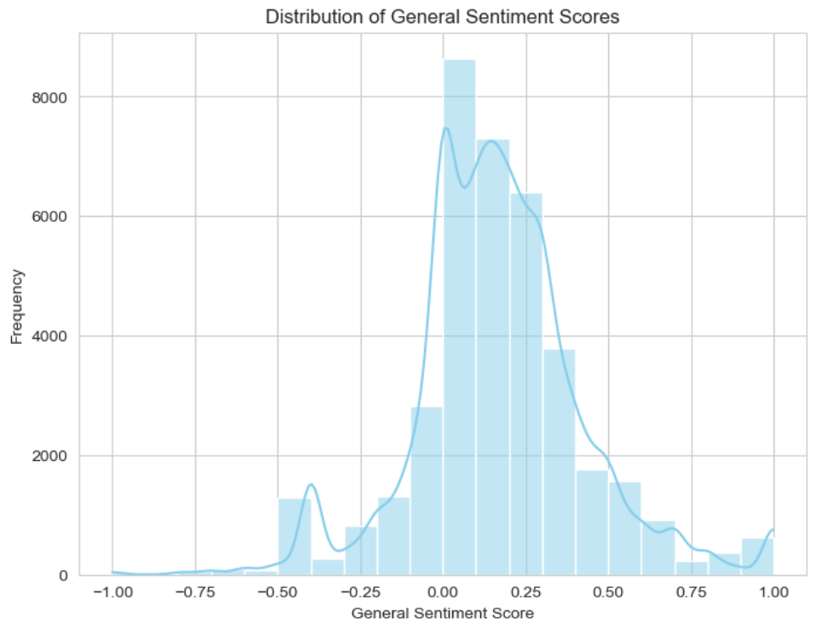

Slide 8
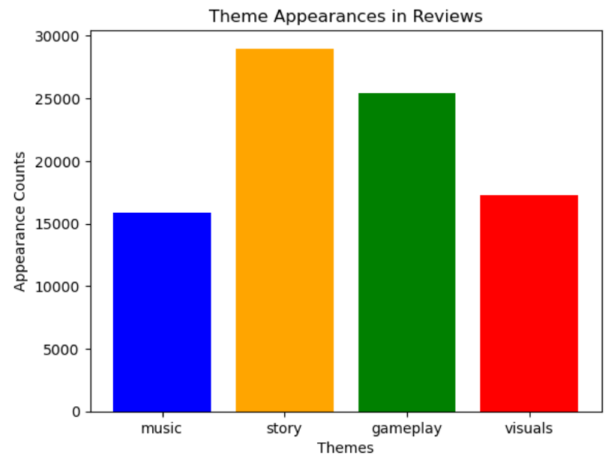

Slide 9
TOP 5 BIGRAMS BY THEME
Music | Story | Gameplay | Visuals
Sound, track - 10 | Side, quest - 9 | Attack, pattern -13 | Late, party - 9
Instead, audio - 12 | Question, asked - 13 | Power, ups - 8 | Add, cart - 7
Audio, eargasm - 12 | Family, drama - 11 | El, combate - 9 | Vibrant, color - 12
Musical, score - 12 | Extended, family - 14 | Power, creep - 10 | Color, palette -12
Mass, effect - 10 | Answer, question -14 | Micro, transaction - 16 | Farewell, earthly -15

Slide 10
Review Sentiment Analyzer
Review Length: 95
Review: go one best game time . 10/10 everything : story , gameplay , difficulty , art , voice acting .
Theme Words and Polarity
Music: voice acting, 0.548
Story: story, 0.525
Gameplay: gameplay, 0.500
Visuals: art, 0.594

Slide 11
Summary
Above 90% precision rate among all three models.
Oscore is key factor

Slide 12
Recommendations
#1 Incorporate the assessment of Oscore into the screening process to further refine the selection of potential participants.
#2 Target higher Oscores and individuals who have never having taken legal highs, nicotine, or amyl nitrites.

Slide 13
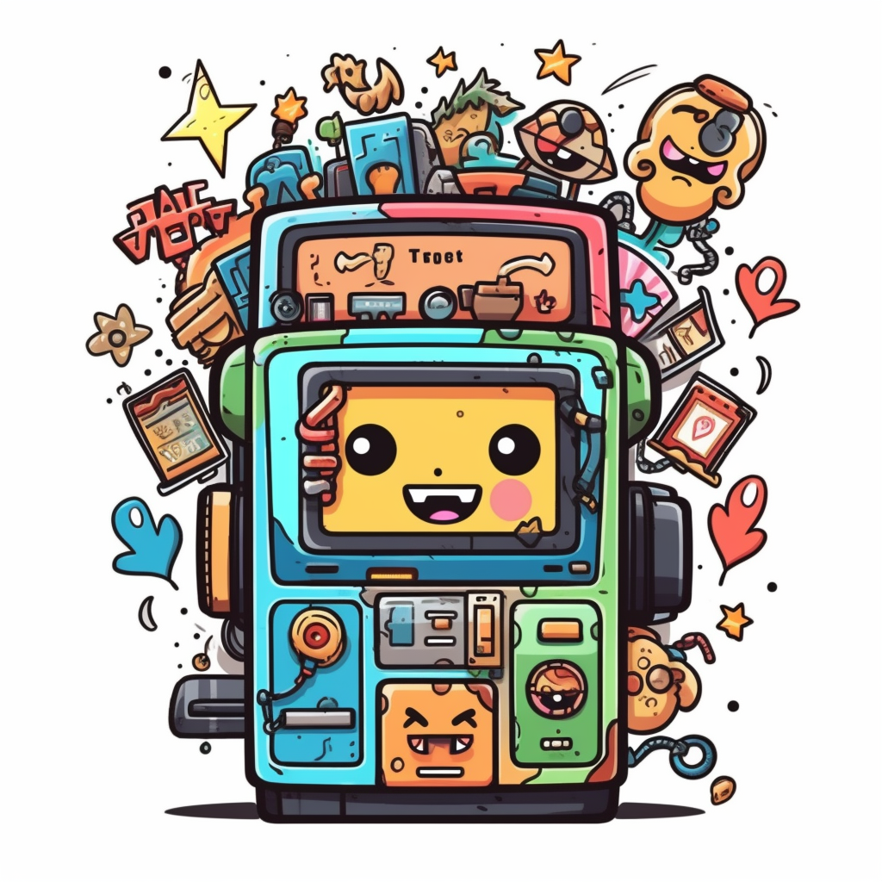
Thank You
Jordan Loewen-Colón
jbloewen@syr.edu

